Slide 1
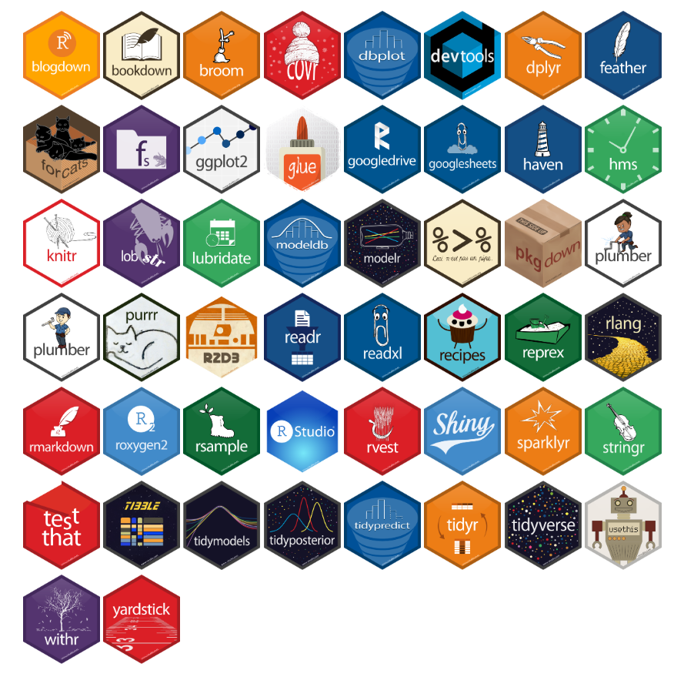
Introduction to R
Twitter: @DataVizJohansen
GitHub: https://github.com/RAJohansen

Slide 2
Workshop Agenda
Workshop Expectations
Why R?
Understanding Data
Data Visualizations in R
Work in R Studio

Slide 3
Workshop Agenda
Workshop Expectations
What is R?
Understanding Data
Data Visualizations in R
Work in R Studio

Slide 4

Expectations
Prerequisites:
R and R studio installed
Goal:
Explore R and R studio environment
Basic functions of R
Import data
Download packages
Simple modeling
Visualize data
Export data and visualization
Caveat
This is only an introduction to the R and R studio environment. Learning a new programming language, like a spoken language, takes years of practice. So we cannot cover everything but we will highlight many common features that most of you will use most of the time.
https://www.visumcx.com/single-post/2017/03/02/The-Value-Of-Setting-Customer-Expectations

Slide 5
Workshop Agenda
Workshop Expectations
What is R?
Understanding Data
Data Visualizations in R
Work in R Studio

Slide 6

What is R?
R is a programming language specifically designed for statistical analysis and graphics
R is free & open-source used in many academic and industry disciplines
R Studio is the Interactive User Interface compatible with R
R and R Studio can be downloaded here:
http://cran.r-project.org/
https://www.rstudio.com/products/RStudio/#Desktop

Slide 7
Why R?
Pros:
Reproducibility
Explicit documentation of steps
Versatile
Run on any operating system
Integrates with other software, languages, and data extensions
Python, Java, SAS, SPSS, Excel
Free and Open-Source w/ large active community
10K+ packages CRAN, Twitter, GitHub, etc.
Comprehensive
Eliminates the need for multiple software
GIS, Excel, ENVI, etc.
Computationally Robust
Fast and allows for high level analysis
Cons:
Steep Learning Curve
Requires a significant time investment especially starting with little to no coding experience
Limited “Point & Click”
R Commander or Radiant?
Open-Source
Rely on creators to follow coding etiquette
Version control and instability

Slide 8
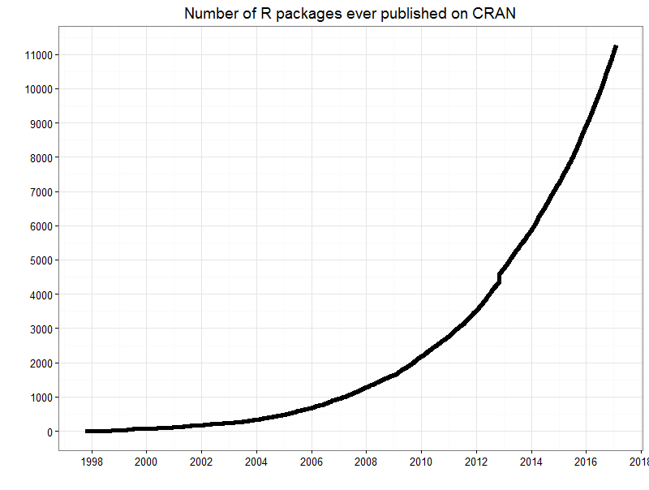
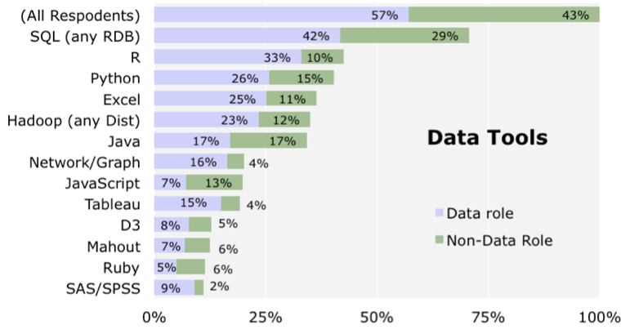
Why R?
Increasing in Popularity (especially in academia)
User contributions significantly increased over the last decade
http://blog.revolutionanalytics.com/2014/01/in-data-scientist-survey-r-is-the-most-used-tool-other-than-databases.html
http://blog.revolutionanalytics.com/2016/03/16-years-of-r-history.html

Slide 9
Workshop Agenda
Workshop Expectations
What is R?
Understanding Data
Data Visualizations in R
Work in R Studio

Slide 10
What is Data?
Data is a collection of objects defined by attributes
An attribute is a property or characteristic of an object
Examples: eye color of a person, temperature, etc.
Synonyms: Columns, variables, fields, characteristics, features, etc.
An object is the phenomena being described or evaluated
Examples: Bob/Sarah, house, substance, etc.
Synonyms: Rows, observations, points, cases, samples, instances, etc.

Slide 11
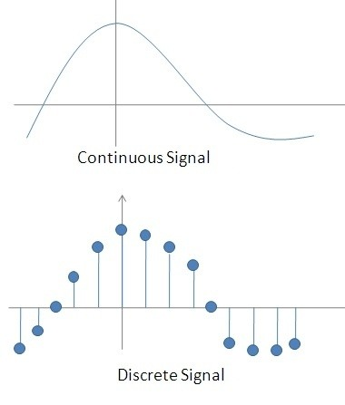
Attribute Classification
Discrete Attribute – has a countable set of values
Examples: zip codes, number of words,
Typically represented as integers
Continuous Attribute - has an infinite set of numbers and potential divisions
Example: temperature, height, weight
Typically represented as floating point (decimal)
https://qph.fs.quoracdn.net/main-qimg-7badb966d5ff6063ddb515737011ed1b-c

Slide 12
Important Attribute Classes
Categorical
Nominal - Data that can be counted, but not aggregated or ordered
Examples: Eye Color, Zip Code, Music Genre
Ordinal - Data that can be counted and ordered, but not aggregated.
Examples: Grades, Clothing Size, Positions (in a race)
Numerical
Interval (metrics) - The difference in values are constant and meaningful
Examples: The difference between a temperature of 100°F and 90°F is the same difference as between 90°F and 80°F.
Ratio - An interval scale with an absolute zero
Examples: Income, Height, Weight

Slide 13
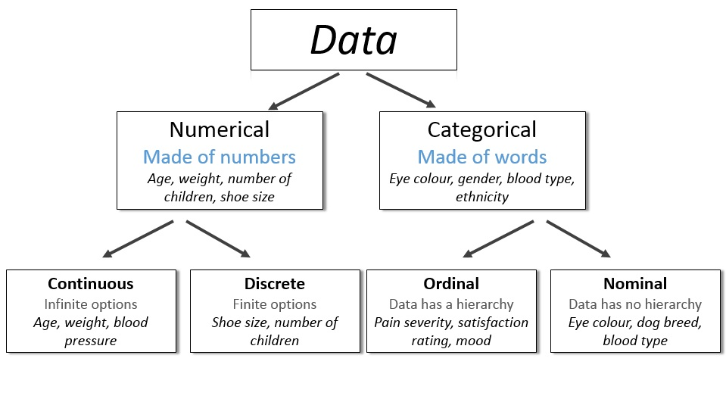
http://survivestatistics.com/variables/

Slide 14
Primitive Data Types (Computer Language Data Types)
Boolean:
True (T) or False (F)
Char:
Characters and Strings – “A”, “Beta”, “There are different data types!”
Int:
Integers – (1, 2, 100)
Float/Double:
Decimal – (0.1, 0.2, 0.1352)

Slide 15
Workshop Agenda
Workshop Expectations
What is R?
Understanding Data
Data Visualizations in R
Work in R Studio

Slide 16
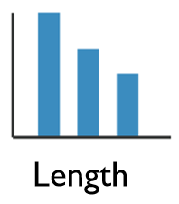
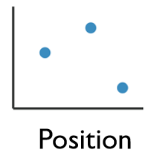
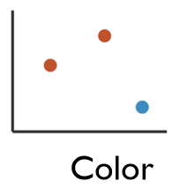
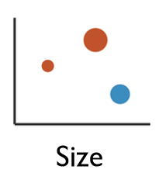
Enhancing Visualizations
1 Dimensional Data
Length
2 Dimensional Data
Position
2+ Dimensional Data
Position
Color Hue/Saturation
Size
Shape

Slide 17
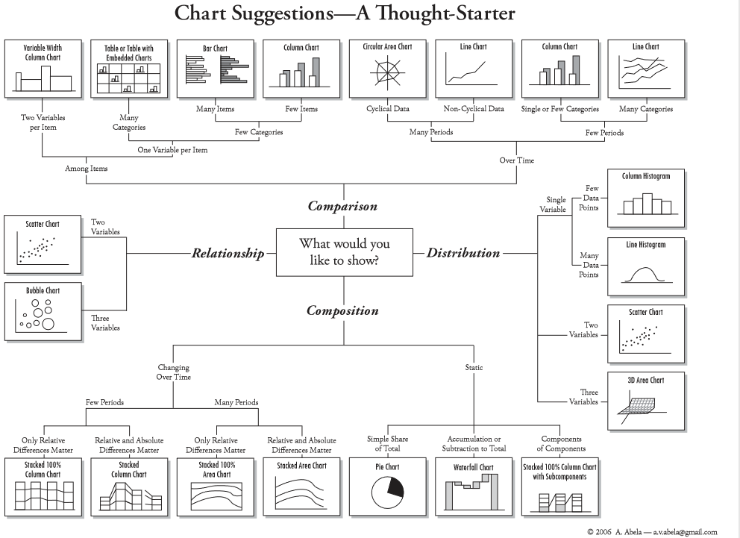
Four Basic Chart Types
http://extremepresentation.typepad.com/files/choosing-a-good-chart-09.pdf

Slide 18
Grammar of Graphics
Originated by Leland Wilkinson, simplified by Hadley Wickham and others.
Data – The raw materials of your visualization
Layers – What you actually see on the plot (plots,lines,etc.)
Scales – Maps the data to grpahical output
Coordinates – The visualization’s perspective (normally a grid)
Faceting – Provides details into the data (analoguous to pivot tables)
Themes – Control the details of the display (color scheme, fonts)
http://vita.had.co.nz/papers/layered-grammar.pdf
Notes:
Alison

Slide 19
The Basics
Data – The raw materials of your visualization
Aesthetics – The mapping of your data to the visualization
X-axis is age
Y-axis is survival
Layers – Any visualization requires at least one layer and in ggplot2 these are typically the geoms.
Example a barchart is geom_bar()

Slide 20
Want to continue learning R?
Academic Courses:
CS 2005C – Introduction to Programming for Informatics with Python and R
BE 8083 – Data Analysis with R and SAS
BANA 5143 – Statistical Computing
PH 7011 – Statistical Computation and Software
Lynda (Many free courses):
Learning R
Data Wrangling with R
R Statistics Essential Training
Library Workshops:
https://webapps2.uc.edu/ce/facdev/Workshops

Slide 21
Additional Online Resources
Google!
www.YouTube.com
www.stackoverflow.com
www.r-bloggers.com
Twitter: #rstats

Slide 22
UC R User Group
Expected initial meeting January 2019!
The main goal is to create a community of R users from all levels of experience and variety of academic interests:
Events & Workshops
Monthly challenges (prizes!)
Research Collaborations
Hack-a-thons
Coffee & Donuts!
Email signup form is in the back of the room

Slide 23
Contact Research & Data Services West
Email: AskData@uc.edu
Web: https://libraries.uc.edu/digital-scholarship/data-services.html
Visit: 240 Braunstein Hall (Geology-Math-Physics Library)
Consultations: walk-ins during open consultation hours or appointment by email
Twitter: @DataVizJohansen
GitHub: https://github.com/RAJohansen

